Slide 1
Statistical Interfaces

Slide 2

Tea-Test(t-test)
The t-test assesses whether the means of two groups are statistically different from each other.
This analysis is appropriate whenever you want to compare the means of two groups

Slide 3
Step 1: Null Hypothesis
Step 2: Setting the level of risk
Step 3: Select appropriate t-statistics: t-test for independent means
Step 4: Compute the t-value
Step 5: Determine the critical t-value
Step 6: Compare
Step 7: Decide

Slide 4
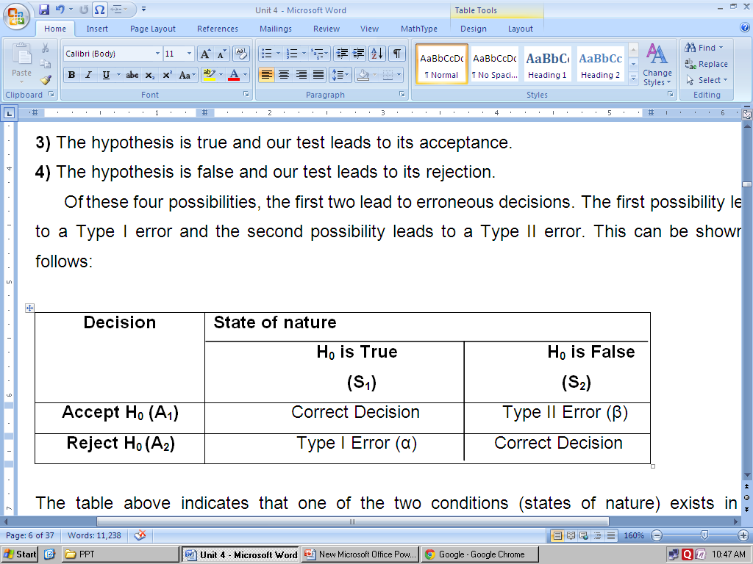
4.2Hypothesis
D) Types of Errors in Hypothesis Testing:
At this stage, it is worthwhile to know that when a hypothesis is tested, there are four possibilities:
1) The hypothesis is true but our test leads to its rejection.
2) The hypothesis is false but our test leads to its acceptance.
3) The hypothesis is true and our test leads to its acceptance.
4) The hypothesis is false and our test leads to its rejection.
Of these four possibilities, the first two lead to erroneous decisions. The first possibility leads to a Type I error and the second possibility leads to a Type II error. This can be shown as follows:

Slide 5
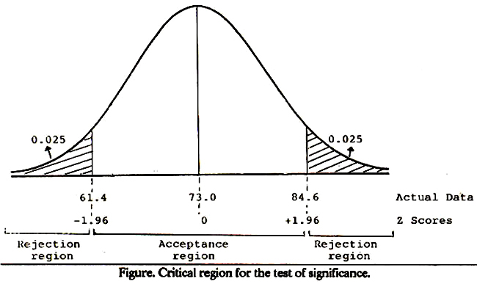

Slide 6
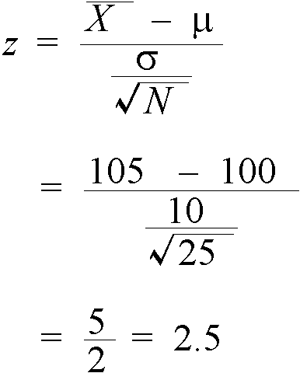
Testing Hypotheses about Single Means when the Population Variance is Known -One sample -A single variable against a known or given standard -
Example: say that I sampled 25 undergraduate students at Scarborough and measured their IQ, finding a mean of 105. Is this mean significantly different from the population which has a mean IQ of 100 and a standard deviation of 10.

Slide 7
Independent t-test (Two Samples)
Suppose , as a marketer of a brand of jeans ,we wanted to find out whether a set of customers in Delhi and a set of customer in mumbai thought of our brand in the same way or not . Suppose we conducted a survey in both cities and got ratings on an interval scale (assume it is 7 point scale rating from 1 to 7) fro our customers. We now want to do a statistical test to find out if the two sets of rating are “significantly different “ from each other or not. We have to now set a level of “ statistical significance” and select a suitable test. We also need to specify null hypothesis.
The Null hypothesis for the t-test would be “ There is no significance difference in rating given by customers in Mumbai and Delhi”

Slide 8
Two sample independent :T-test
Perception of the customers of Mumbai and Delhi for a brand of Jeans.
Two samples: customers from Mumbai and Delhi
The customers are asked at 7 point scale, where = 1 =strongly agree and 7 =strongly agree.
Level of significance= 5% Level of Significance

Slide 9
Paired t- test( Two Samples)
In some cases , we may not have independent samples , but the same sample could be used to do a research study involving measurements. For example , we may measure somebody’s attitude towards a brand before it is advertised and after it is advertised , to try and find out if their attitude has changed due to the campaign. In such cases ,a paired t-test is the appropriate statistical test.
Example: Assume that we used a sample of 18 respondents whom we asked to rate on a 10 point interval scale ,their attitude towards say Provogue Brand of Garments before and after ad campaign was released for this brand. A rating of 1 represents “ Brand is highly Disliked” and a rating of 10 repents “ Brands is highly liked” with other ratings having appropriate meaning.
We set the level of significance at 5%.

Slide 10
Paired Sample –T-test
1. Perception of the customers for a brand of Jeans of Mumbai before and after advertisement.
Sample: same sample before and after the advertisement
The customers are asked at 7 point scale, where = 1 =strongly agree and 7 =strongly agree.
Level of significance= 5% Level of Significance

Slide 11
One-Way ANOVA
One-Way Analysis of Variance

Slide 12
One-Way ANOVA
The one-way analysis of variance is used to test the claim that three or more population means are equal
This is an extension of the two independent samples t-test

Slide 13
One-Way ANOVA
The response variable is the variable you’re comparing
The factor variable is the categorical variable being used to define the groups
We will assume k samples (groups)
The one-way is because each value is classified in exactly one way
Examples include comparisons by gender, race, political party, color, etc.

Slide 14
One-Way ANOVA
Conditions or Assumptions
The data are randomly sampled
The variances of each sample are assumed equal
The residuals are normally distributed

Slide 15
One-Way ANOVA
The null hypothesis is that the means are all equal
The alternative hypothesis is that at least one of the means is different

Slide 16
One-Way ANOVA
The statistics classroom is divided into three rows: front, middle, and back
The instructor noticed that the further the students were from him, the more likely they were to miss class or use an instant messenger during class
He wanted to see if the students further away did worse on the exams

Slide 17
One-Way ANOVA
The ANOVA doesn’t test that one mean is less than another, only whether they’re all equal or at least one is different.

Slide 18
One-Way ANOVA
A random sample of the students in each row was taken
The score for those students on the second exam was recorded
Front: 82, 83, 97, 93, 55, 67, 53
Middle: 83, 78, 68, 61, 77, 54, 69, 51, 63
Back: 38, 59, 55, 66, 45, 52, 52, 61

Slide 19
One-Way ANOVA
The summary statistics for the grades of each row are shown in the table below
Row | Front | Middle | Back
Sample size | 7 | 9 | 8
Mean | 75.71 | 67.11 | 53.50
St. Dev | 17.63 | 10.95 | 8.96
Variance | 310.90 | 119.86 | 80.29

Slide 20
One-Way ANOVA
Variation
Variation is the sum of the squares of the deviations between a value and the mean of the value
Sum of Squares is abbreviated by SS and often followed by a variable in parentheses such as SS(B) or SS(W) so we know which sum of squares we’re talking about

Slide 21
One-Way ANOVA
Are all of the values identical?
No, so there is some variation in the data
This is called the total variation
Denoted SS(Total) for the total Sum of Squares (variation)
Sum of Squares is another name for variation

Slide 22
One-Way ANOVA
Are all of the sample means identical?
No, so there is some variation between the groups
This is called the between group variation
Sometimes called the variation due to the factor
Denoted SS(B) for Sum of Squares (variation) between the groups

Slide 23
One-Way ANOVA
Are each of the values within each group identical?
No, there is some variation within the groups
This is called the within group variation
Sometimes called the error variation
Denoted SS(W) for Sum of Squares (variation) within the groups

Slide 24
One-Way ANOVA
There are two sources of variation
the variation between the groups, SS(B), or the variation due to the factor
the variation within the groups, SS(W), or the variation that can’t be explained by the factor so it’s called the error variation

Slide 25
One-Way ANOVA
Here is the basic one-way ANOVA table
Source | SS | df | MS | F | p
Between
Within
Total

Slide 26
One-Way ANOVA
Grand Mean
The grand mean is the average of all the values when the factor is ignored
It is a weighted average of the individual sample means

Slide 27
One-Way ANOVA
Grand Mean for our example is 65.08

Slide 28
One-Way ANOVA
Between Group Variation, SS(B)
The between group variation is the variation between each sample mean and the grand mean
Each individual variation is weighted by the sample size

Slide 29
One-Way ANOVA
The Between Group Variation for our example is SS(B)=1902
I know that doesn’t round to be 1902, but if you don’t round the intermediate steps, then it does. My goal here is to show an ANOVA table from MINITAB and it returns 1902.

Slide 30
One-Way ANOVA
Within Group Variation, SS(W)
The Within Group Variation is the weighted total of the individual variations
The weighting is done with the degrees of freedom
The df for each sample is one less than the sample size for that sample.

Slide 31
One-Way ANOVA
Within Group Variation

Slide 32
One-Way ANOVA
The within group variation for our example is 3386

Slide 33
One-Way ANOVA
After filling in the sum of squares, we have …
Source | SS | df | MS | F | p
Between | 1902
Within | 3386
Total | 5288

Slide 34
One-Way ANOVA
Degrees of Freedom, df
A degree of freedom occurs for each value that can vary before the rest of the values are predetermined
For example, if you had six numbers that had an average of 40, you would know that the total had to be 240. Five of the six numbers could be anything, but once the first five are known, the last one is fixed so the sum is 240. The df would be 6-1=5
The df is often one less than the number of values

Slide 35
One-Way ANOVA
The between group df is one less than the number of groups
We have three groups, so df(B) = 2
The within group df is the sum of the individual df’s of each group
The sample sizes are 7, 9, and 8
df(W) = 6 + 8 + 7 = 21
The total df is one less than the sample size
df(Total) = 24 – 1 = 23

Slide 36
One-Way ANOVA
Filling in the degrees of freedom gives this …
Source | SS | df | MS | F | p
Between | 1902 | 2
Within | 3386 | 21
Total | 5288 | 23

Slide 37
One-Way ANOVA
Variances
The variances are also called the Mean of the Squares and abbreviated by MS, often with an accompanying variable MS(B) or MS(W)
They are an average squared deviation from the mean and are found by dividing the variation by the degrees of freedom
MS = SS / df

Slide 38
One-Way ANOVA
MS(B) = 1902 / 2 = 951.0
MS(W) = 3386 / 21 = 161.2
MS(T) = 5288 / 23 = 229.9
Notice that the MS(Total) is NOT the sum of MS(Between) and MS(Within).
This works for the sum of squares SS(Total), but not the mean square MS(Total)
The MS(Total) isn’t usually shown

Slide 39
One-Way ANOVA
Completing the MS gives …
Source | SS | df | MS | F | p
Between | 1902 | 2 | 951.0
Within | 3386 | 21 | 161.2
Total | 5288 | 23 | 229.9

Slide 40
One-Way ANOVA
Special Variances
The MS(Within) is also known as the pooled estimate of the variance since it is a weighted average of the individual variances
Sometimes abbreviated
The MS(Total) is the variance of the response variable.
Not technically part of ANOVA table, but useful none the less

Slide 41
One-Way ANOVA
F test statistic
An F test statistic is the ratio of two sample variances
The MS(B) and MS(W) are two sample variances and that’s what we divide to find F.
F = MS(B) / MS(W)
For our data, F = 951.0 / 161.2 = 5.9

Slide 42
One-Way ANOVA
Adding F to the table …
Source | SS | df | MS | F | p
Between | 1902 | 2 | 951.0 | 5.9
Within | 3386 | 21 | 161.2
Total | 5288 | 23 | 229.9

Slide 43
One-Way ANOVA
The F test is a right tail test
The F test statistic has an F distribution with df(B) numerator df and df(W) denominator df
The p-value is the area to the right of the test statistic
P(F2,21 > 5.9) = 0.009

Slide 44
One-Way ANOVA
Completing the table with the p-value
Source | SS | df | MS | F | p
Between | 1902 | 2 | 951.0 | 5.9 | 0.009
Within | 3386 | 21 | 161.2
Total | 5288 | 23 | 229.9

Slide 45
One-Way ANOVA
The p-value is 0.009, which is less than the significance level of 0.05, so we reject the null hypothesis.
The null hypothesis is that the means of the three rows in class were the same, but we reject that, so at least one row has a different mean.

Slide 46
One-Way ANOVA
There is enough evidence to support the claim that there is a difference in the mean scores of the front, middle, and back rows in class.
The ANOVA doesn’t tell which row is different, you would need to look at confidence intervals or run post hoc tests to determine that

Slide 47
ANOVA with replication
A two way ANOVA with replication is performed when you have two groups and individuals within that group are doing more than one thing (i.e. taking two tests). If you only have one group, use a two way ANOVA in Excel without replication.

Slide 48
ANOVA without Replication
A Two way ANOVA in Excel without replication can compare a group of individuals performing more than one task.

